Slide 1
Shopping in
London

Slide 2
Top shopping destinations
•Oxford Street
•Carnaby Street
•Regent Street
•Westfield London

Slide 3
OXFORD STREET
Oxford Street is said to be the busiest shopping street in Europe
Most shops open at 10am and close at6 or 7pm (many are also opened on Sunday from 12 to 6pm with late nights on Thursdays)

Slide 4
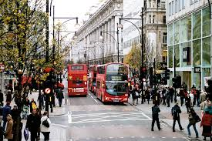
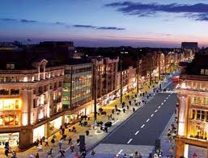
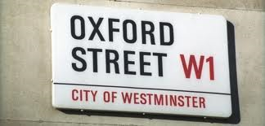

Slide 5
CARNABY STREET
Carnaby Street is famous shopping street located near Oxford Street and Regent Street
It is home to numerous fashion and lifestyle retailers, including a large number of independent fashion boutiques
numerous- brojni
retailers- prodavač na malo
independent- nezavisni

Slide 6
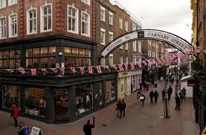
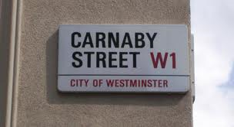

Slide 7
REGENT STREET
Regent street is one of the major shopping streets in London's West End, well known to tourists and Londoners
It is also famous for its Christmas illuminations
Regent Street is named after the Prince Regent

Slide 8
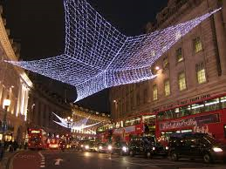
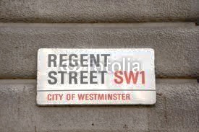

Slide 9
WESTFIELD LONDON
Westfield London is a shopping centre in White City (a district)
It was opened on 30th October 2008
The centre is noted for its size- 150 000m²
district- okrug

Slide 10
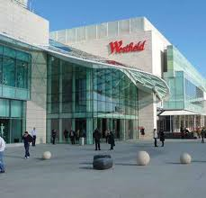
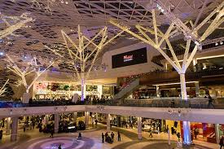

Slide 11
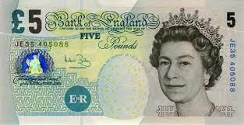
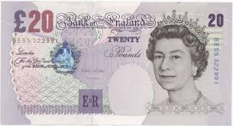
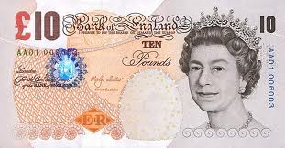
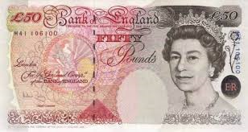
BRITISH MONEY
Pounds and pence are the British money
This is the pound sign £
If you are in UK and you need to change money you can do it at Barclays, Lloyds TSB or some other British bank

Slide 12
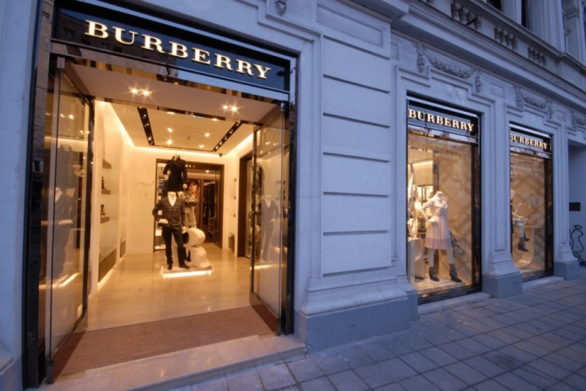
FAMOUS SHOPS IN LONDON

Slide 13
THE END!
HOPE YOU ENJOYED
☺
MADE IN CROATIA BY:
Leonarda Stanarević, 6.B
OŠ BUKOVAC

